Slide 1


TEAM SWATIKA
Amit Verma (Branch: IT)
Shorya (Branch: IT)
Aniket Mishra (Branch: CSE AIML)
Praveen Kushwaha (Branch: IT)
Sneha Bansal (Branch: CSE)

Slide 2

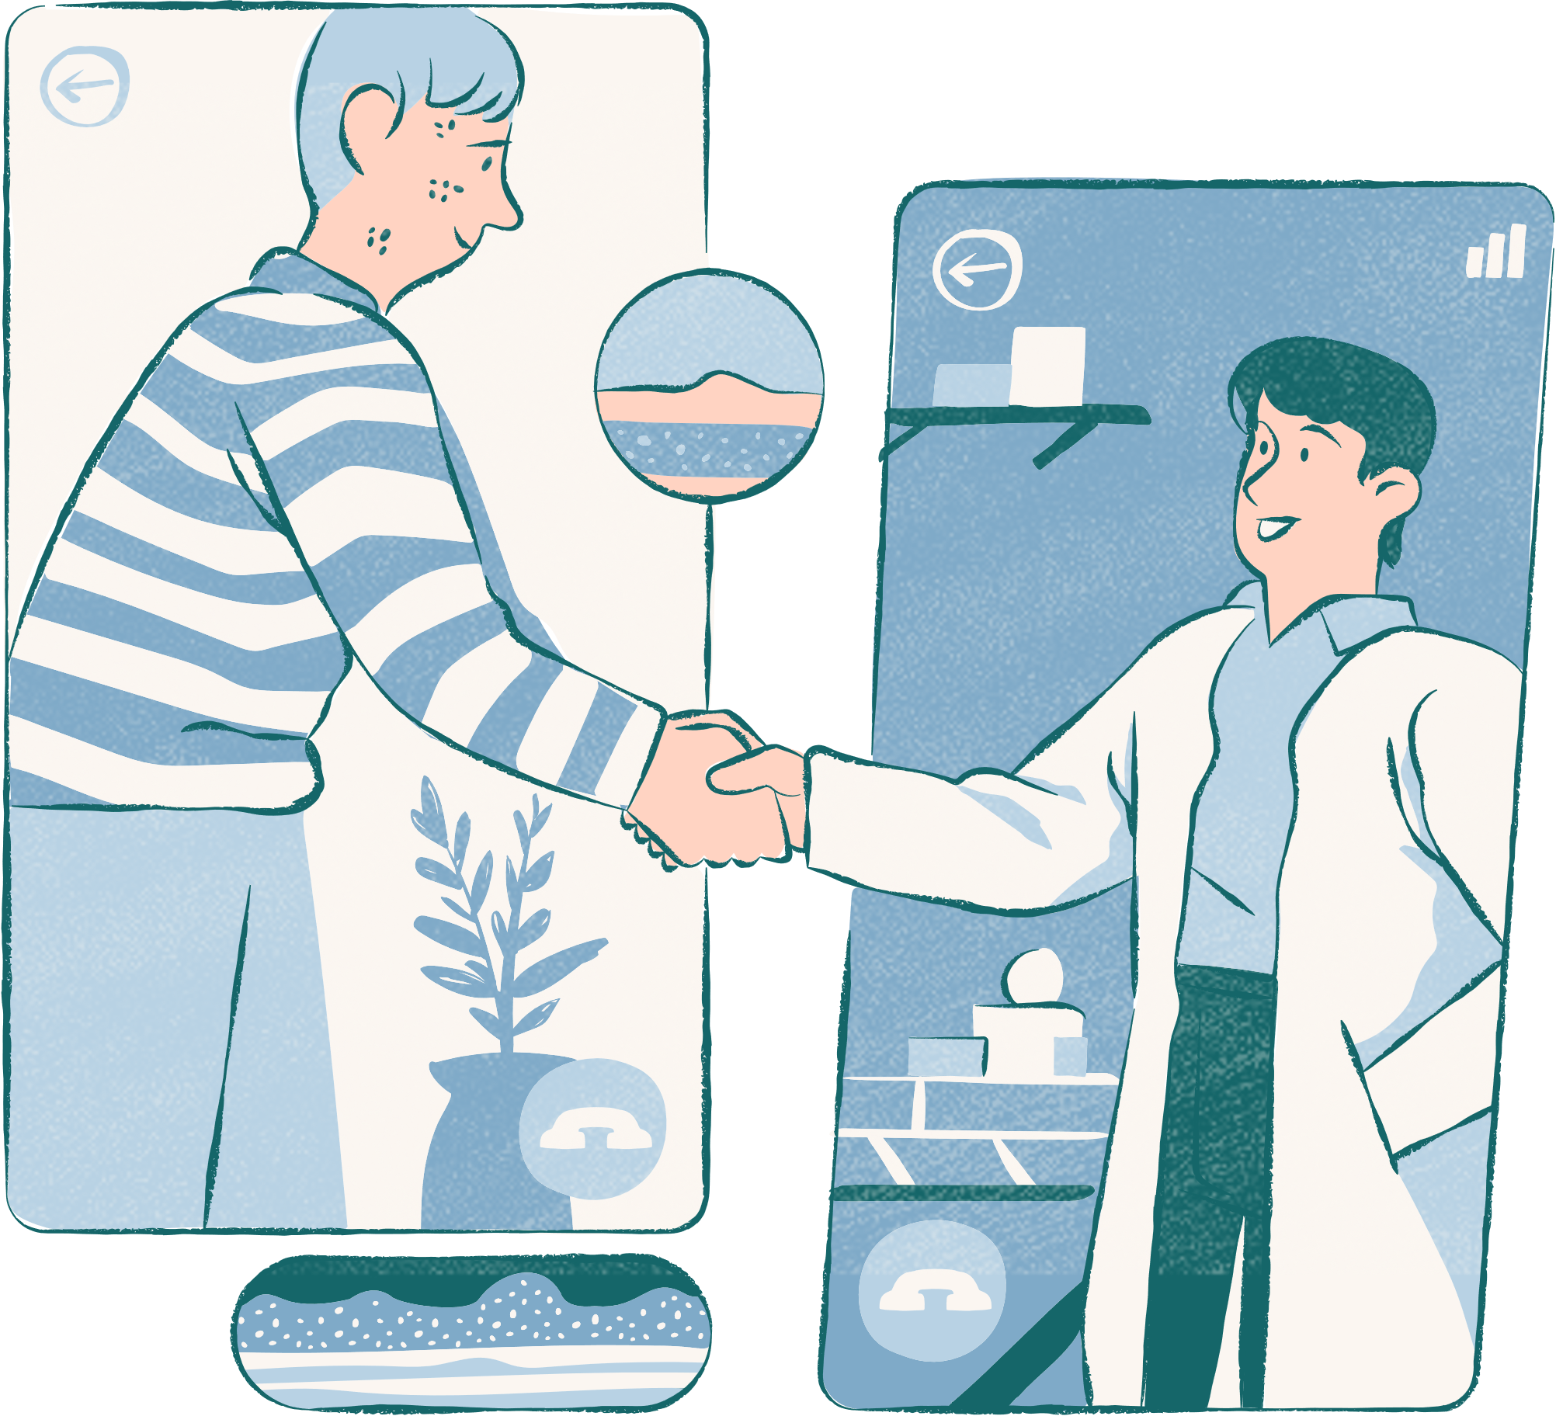
Problem Statement
Health care in rural India is still an unresolved area that demands improved and innovative solutions. The easy availability and access to expert doctors, according to the medical condition of the individual/patient can be provided by the Al-assisted telemedicine robotic Kiosk that can be set up anywhere in the village. Individuals may mark their identity through the biometric scanner. A robot may speak to the individual, enquiring about the illness. Later, the individual will be directed online to an expert doctor, via e-sanjeevani App. After the consultation, medicines and other associated services can be provided to them through the local Asha worker without any delay
Software

Slide 3
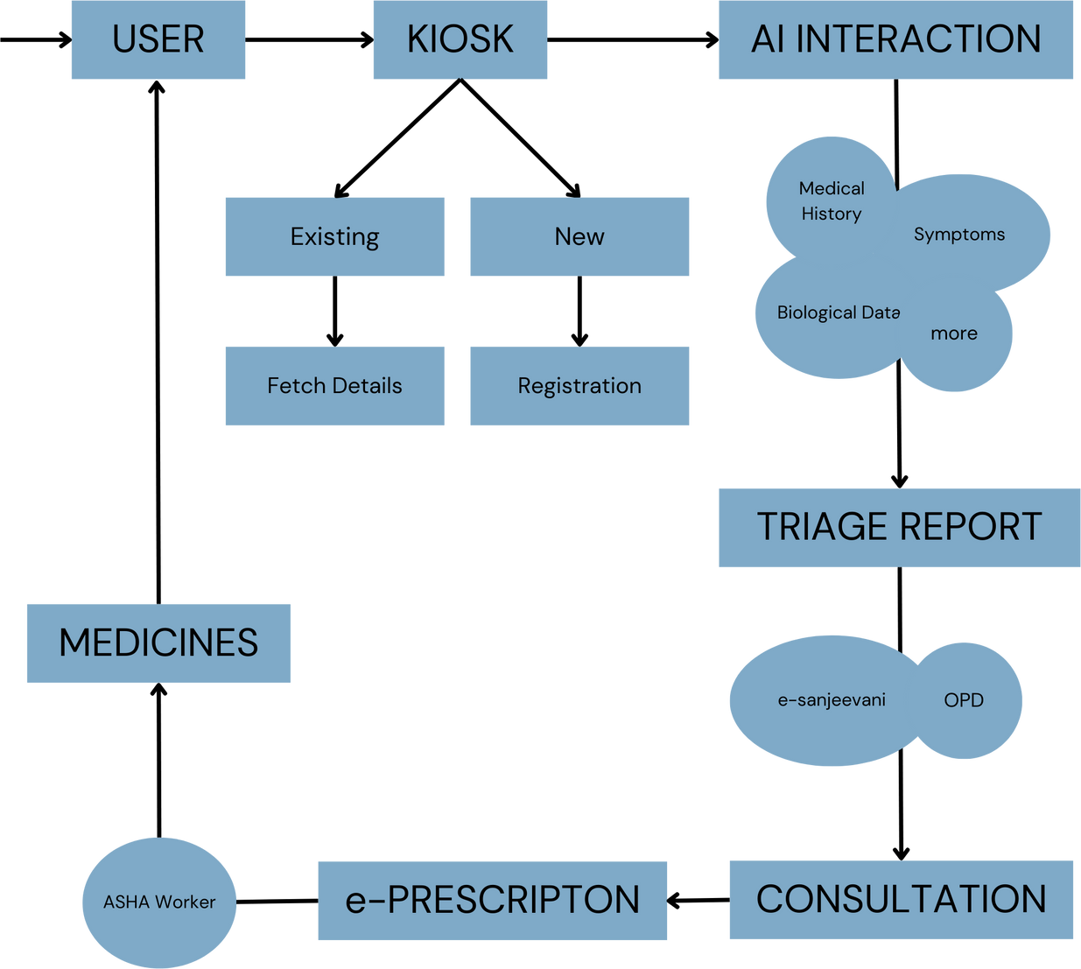
Solution
AI Web App for KIOSK
Biometric Identity
Speaking AI
Asking about illness
Making Report
Quick tests
Expert Doctor Consultation
e-Prescription
Medicine provided

Slide 4
Unique Features
Impacts
➔ Emergency Response Integration:
◆ Integrate an emergency button on the kiosk, enabling immediateness to emergency services.
◆ AI algorithms can prioritize emergency cases based on severity.
➔ Health Insurance Integration:
◆ Partner with insurance providers to facilitate the purchase of affordable health insurance plans through the kiosk.
◆ Provide guidance on insurance claims and coverage.
Improved Healthcare access
Early Disease detection
Reduced travel burden
Emergency care
Data collection and analysis
Chronic disease management
Reduced health disparities

Slide 5
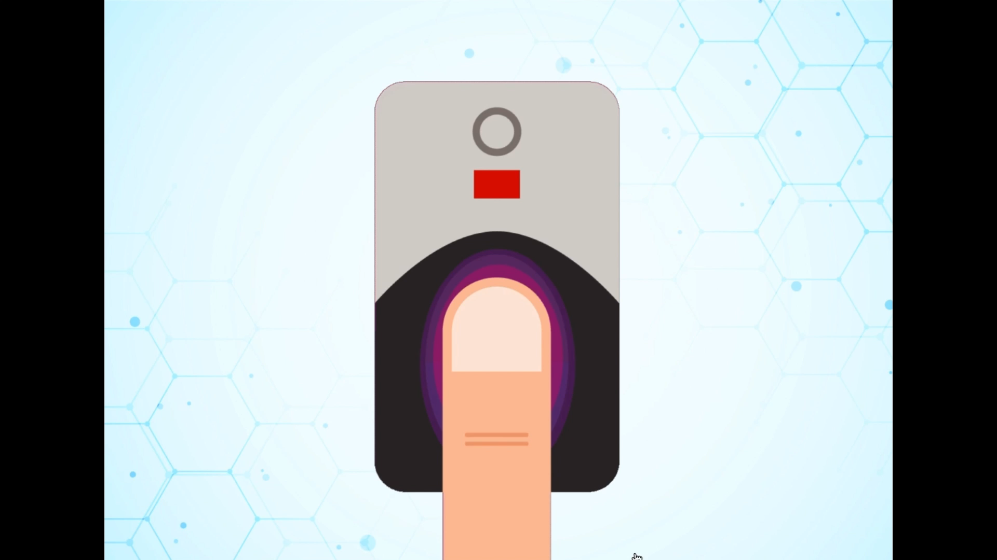


Slide 6



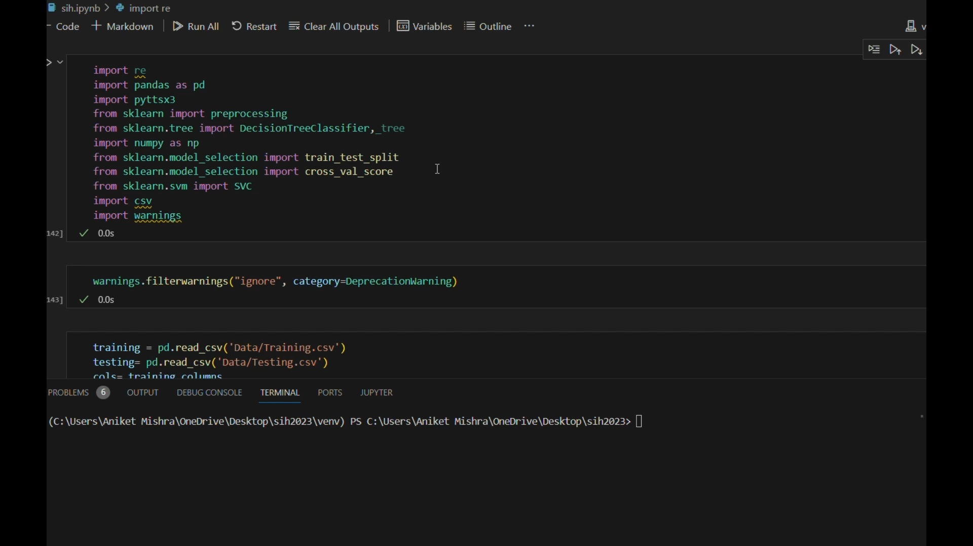










Technology
The code shows the ML model of NLP and it’s working

Slide 7
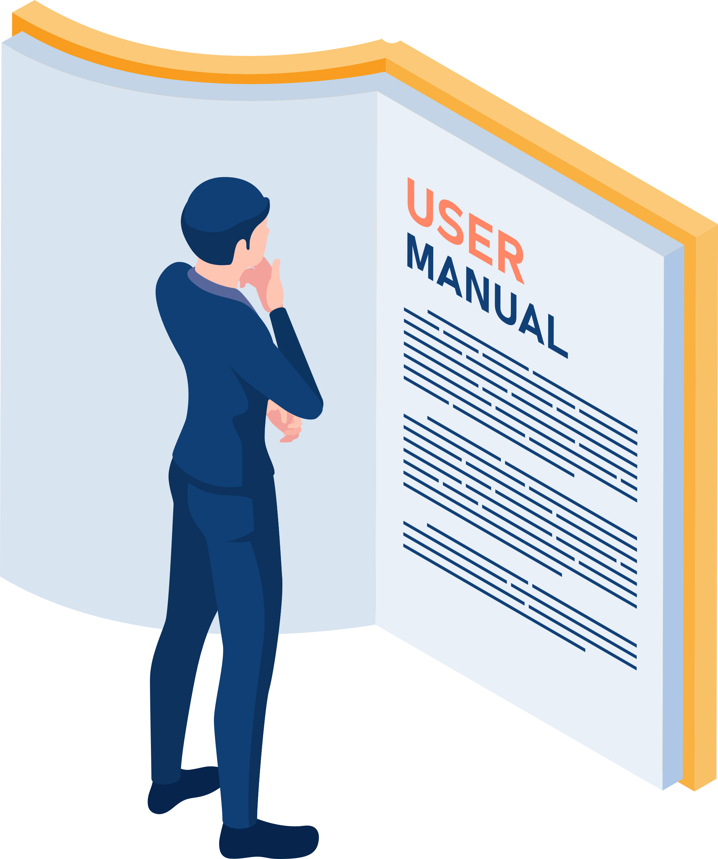







Dependencies of the Software
CRITICAL
MANAGABLE
Test Sensors
Electricity
User Training
Database
ASHA Worker
Internet
KIOSK Hardware
Expert Availability

